Slide 1
Farm Business Confidence Survey

Slide 2
OFA Membership Survey
The Purpose of the Survey was to assess OFA members confidence in their farm business and the Ontario ag-sector.
The survey was available online from Dec 2nd – Dec 20th 2024
The survey was open to all OFA members.
Respondents had the option to skip questions.
Respondents may have been ineligible to answer certain questions based on their answer to previous questions.
In total there were 1,061 respondents.

Slide 3
Please select your County or Region
County | % of responses | # of responses
Kent | 4.9 | 52
Niagara (North and South) | 4.8 | 51
Middlesex | 4.7 | 50
Perth | 4.7 | 50
Simcoe | 4.5 | 48
Huron | 4.5 | 47
Lambton | 4.3 | 45
Oxford | 4.1 | 43
Wellington | 3.7 | 39
Elgin | 3.7 | 39
Bruce | 3.6 | 38
Norfolk | 3.1 | 33
Essex | 3 | 32
Peterborough | 2.7 | 29
Haldimand | 2.7 | 28
Northumberland | 2.5 | 26
Durham | 2.4 | 25
Ottawa | 2.2 | 23
Kawartha Lakes & Haliburton | 2.2 | 23
Grey | 2.2 | 23
Waterloo | 1.9 | 20
Dundas | 1.9 | 20
Brant | 1.8 | 19
Renfrew | 1.5 | 16
Temiskaming | 1.4 | 15
Leeds | 1.3 | 14
County | % of responses | # of responses
Lennox & Addington | 1.3 | 14
Lanark | 1.3 | 14
Peel | 1.3 | 14
Halton | 1.1 | 12
Prince Edward | 1.1 | 12
Glengarry | 1.1 | 12
York | 1 | 11
Dufferin | 1 | 11
Hastings | 1 | 11
Russell | 0.9 | 10
Stormont | 0.9 | 10
Hamilton-Wentworth | 0.9 | 9
Algoma | 0.8 | 8
Manitoulin-North Shore & Sudbury West | 0.7 | 7
West Nipissing & Sudbury East | 0.7 | 7
East Nipissing &“ Parry Sound | 0.7 | 7
Prescott | 0.6 | 6
Thunder Bay | 0.6 | 6
Frontenac | 0.5 | 5
Arnprior | 0.5 | 5
Cochrane | 0.4 | 4
Grenville | 0.4 | 4
Rainy River | 0.4 | 4
Kenora & Dryden | 0.2 | 2
Muskoka | 0.2 | 2

Slide 4
What commodities did you produce in 2024?
Commodity | % of respondents | # of responses
Soybeans | 60% | 625
Corn | 54% | 557
Wheat | 41% | 429
Hay and Clover | 31% | 325
Cattle and Calves | 26% | 266
Chickens | 8% | 87
Eggs | 8% | 79
Sheep and Lambs | 6% | 66
Dairy Products | 6% | 66
Oats | 6% | 65
Hogs | 6% | 62
Fruit | 6% | 60
Field Vegetables | 6% | 60
Barley | 5% | 53
Maple Products | 4% | 38
Turkeys | 3% | 26
Honey | 2% | 21
Floriculture | 2% | 20
Potatoes | 2% | 17
Christmas Tree | 1% | 9
Greenhouse Vegetables | 1% | 8
Hazelnuts | 1% | 6

Slide 5
What is your farm income range?

Slide 6
What is your Business Structure?
Business Structure | % of respondents | # of responses
Sole proprietorship | 42% | 438
Corporation | 31% | 317
Partnership | 26% | 272
Other | 1% | 11

Slide 7
How would you describe your experience with farming?
Farming Experience | % of respondents | # of responses
Established farmer | 71% | 745
Retiring Farmer | 18% | 189
New farmer | 8% | 80
Other | 3% | 28

Slide 8
What is your current age range?
Age Range | % of respondents | # of responses
60 and above | 66% | 676
35-59 | 27% | 281
Under 35 | 4% | 39
Prefer not to say | 3% | 35

Slide 9
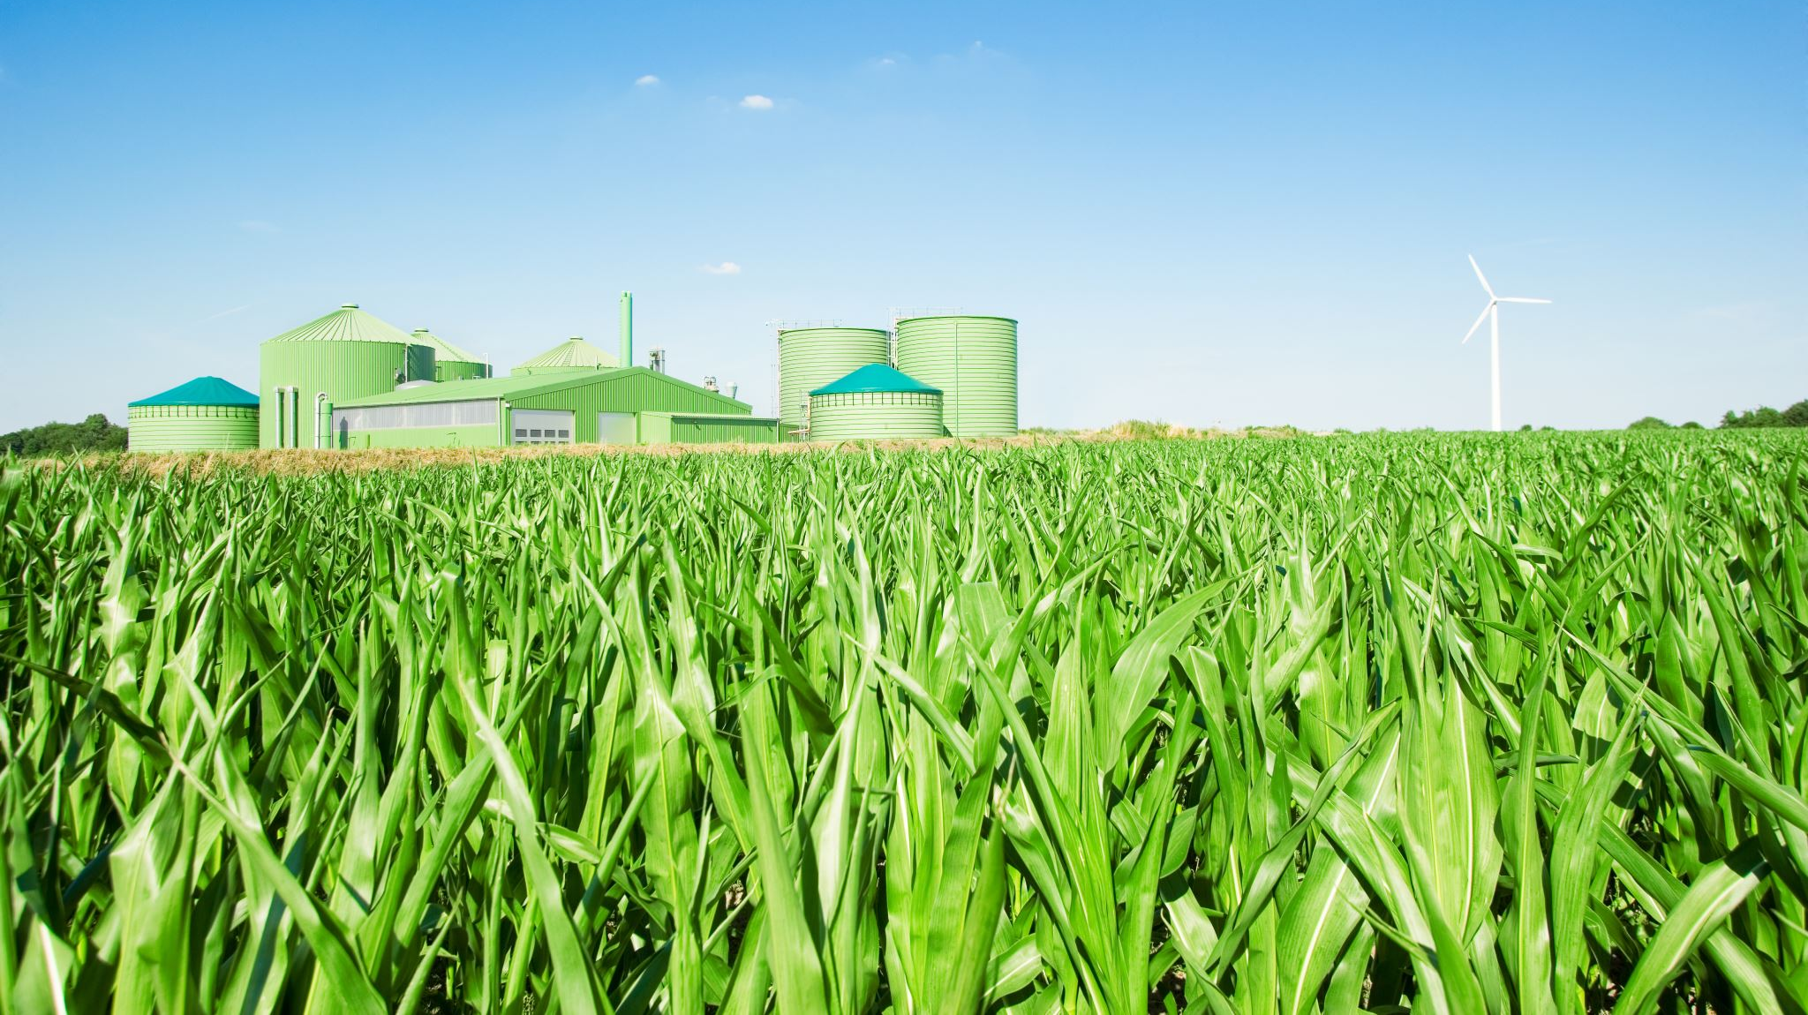
On Farm Investments in 2024

Slide 10
Which phrase best describes the growth of your farm business in 2024?

Slide 11
Did you buy or rent additional acres of land in 2024?

Slide 12
Did you expand the size of your herd or flock in 2024?
 | 2024 | 2023
Yes | 15% | 25%

Slide 13
If you are a greenhouse producer, did you add to your total square footage in 2024?
 | 2024 | 2023
Yes | 3% | 2%

Slide 14
Did you construct new farm structures (e.g., barns, storage facilities) in 2024?
 | 2024 | 2023
Yes | 11% | 13%

Slide 15
Did you purchase new or used machinery in 2024?
 | 2024 | 2023
Yes | 45% | 48%

Slide 16
Did you purchase new or used machinery in 2024?
 | 2024 | 2023
New | 29% | 27%
Used | 53% | 53%
Both | 18% | 19%

Slide 17
Did you invest in new farming technologies (e.g., precision agriculture, automation) in 2024?
 | 2024 | 2023
Yes | 12% | 16%

Slide 18
Did you invest in direct-to-consumer marketing initiatives in 2024? (e.g. through a website, social media, sign to on-farm store, etc.)
 | 2024 | 2023
Yes | 11% | 13%

Slide 19
Did you invest in on-farm retail and/or processing facilities in 2024?
 | 2024 | 2023
Yes | 4% | 6%

Slide 20
Did you make any investments to increase the energy efficiency of your farm business in 2024?
 | 2024 | 2023
Yes | 15% | 16%

Slide 21
Did you diversify the range of agricultural commodities you produce in 2024?
 | 2023 | 2024
Yes | 9% | 10%

Slide 22
Which new commodities did you start producing? in 2024?
Top 3 | % of respondents
Wheat | 13%
Soybeans | 12%
Field vegetables | 9%

Slide 23
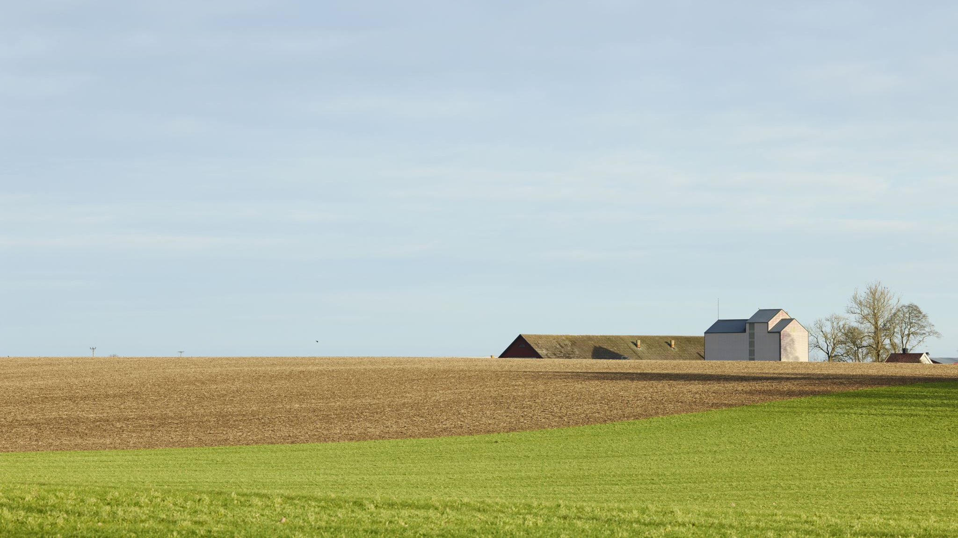
Farm Business Confidence

Slide 24
How confident are you in the outlook for the farm sector in Ontario in 2025?

Slide 25
How confident are you in the outlook for your own farm businesses in 2025?

Slide 26
Farmer confidence in own business vs Industry—2025

Slide 27
Expected Vs. Actual Business Growth 2024

Slide 28
Which phrase best describes how you believe your farm business will change in 2025?

Slide 29
Please select all the policy priorities that would be helpful for your farm business or commodity sector
Policy Priorities (showing Top 10) | Percentage of Respondents
Reducing farm taxes | 71%
Support for farmers with energy costs | 51%
Protecting the right of property access | 45%
Encouraging Ontarians to buy local food | 41%
Expanding natural gas access to rural Ontario | 38%
Support farmers with succession planning | 37%
Improving rural healthcare | 34%
Investments in municipal infrastructure | 34%
Accelerating rural access to high-speed broadband | 32%
Improving farm risk management programs | 31%

Slide 30
Top 3 Member Policy Priorities 2023 Vs 2024
2025 | 2024
1. Reducing farm taxes (71%) | 1. Reducing farm taxes (71%)
2. Support for farmers with energy costs (51%) | 2. Support for farmers with energy costs (62%)
3. Protecting the right of property access (45%) | 3. Encouraging Ontarians to buy local food (47%)

Slide 31
Top Tax Concerns

Slide 32
Over the next year, which one of the following issues is likely to pose the biggest challenge to your farm business?
Rank | Biggest Challenges (2025) | Biggest Challenges (2024)
#1 | Rising input costs | Rising input costs
#2 | Cost of insurance | Interest rates and cost to service debt
#3 | Tax burden | Tax burden
#4 | Municipal policies | Municipal policies
#5 | Interest rates and debt servicing | Cost of insurance
#6 | Succession planning | Labour shortages
#7 | Transportation costs | Succession planning
#8 | Trade and market access | Transportation costs
#9 | Labour shortages | Access to credit
#10 | Access to credit | Trade and access to export markets
#11 | Difficulty acquiring inputs | Difficulty acquiring inputs

Slide 33
Regional Analysis

Slide 34
How confident are you in the outlook for the farm sector in Ontario in 2025?
Notes:
North Most Confident in the Sector for 2024

Slide 35
How confident are you in the outlook for your own farm businesses in 2025?
Notes:
North: Most confident in their own business
More confident in own business vs the sector. Farmers view business climate as difficult, but have belief in their own induvial ability to weather it.

Slide 36
Top 3 Policy Priorities by Geography
North | East | West
1. Reducing farm taxes (64%) | 1. Reducing farm taxes (70%) | 1. Reducing farm taxes (73%)
2. Compensation for wildlife damage to crops (61%) | 2. Protecting the right of property access (50%) | 2. Support for farmers with energy costs (53%)
3. Support for farmers with energy costs (53%) | 3. Encouraging Ontarians to buy local food (45%) | 3. Protecting the right of property access (43%)

Slide 37
Top 3 Concerns in 2024 by Geography
North | East | West
1. Rising input costs (80%) | 1. Rising input costs (73%) | 1. Rising input costs (77%)
2. Cost of insurance (63%) | 2. Cost of insurance (53%) | 2. Cost of insurance (47%)
3. Transportation costs (39%) | 3. Policies and bylaw changes from municipal govt (40%) | 3. Tax burden (49%)

Slide 38
Business Structure Analysis

Slide 39
How confident are you in the outlook for the farm sector in Ontario in 2025?
Notes:
Looking at industry confidence by business structure, there is no clear trend with incorporated farms being slightly more likely to indicate being extremely or very confident, nearly 40% answered that they are not so confident. Between 70%-80% of sole proprietors and partnerships indicated they were either somewhat confident or not so confident.

Slide 40
How confident are you in the outlook for your own farm businesses in 2025?
Notes:
As shown in figure 21 incorporated farmers had the most confidence in their business with 30% reporting feeling either extremely or very confident while sole proprietors were the least confident with only 20% reporting to be extremely or very confident.

Slide 41
Top 3 Policy Priorities in 2025 by Business Structure
Sole Proprietorship | Partnership | Corporation
1. Reducing farm taxes (72%) | 1. Reducing farm taxes (70%) | 1. Reducing farm taxes (71%)
2. Support for farmers with energy costs (49%) | 2. Support for farmers with energy costs (50%) | 2. Support for farmers with energy costs (51%)
3. Protecting the right of property access (44%) | 3. Protecting the right of property access (46%) | 3. Protecting the right of property access (45%)

Slide 42
Top 3 Concerns in 2025 by Business Structure
Sole Proprietorship | Partnership | Corporation
1. Rising input costs (76%) | 1. Rising input costs (78%) | 1. Rising input costs (74%)
2. Cost of insurance (48%) | 2. Cost of insurance (50%) | 2. Cost of insurance (49%)
3. Tax burden (45%) | 3. Interest rates and cost to service debt (47%) | 3. Tax burden (46%)

Slide 43
Famer Age Analysis

Slide 44
How confident are you in the outlook for the farm sector in Ontario in 2025?
Notes:
Farmers' confidence in Ontario's agricultural outlook declines with age. Younger farmers (Under 35) are the most optimistic, with over half expressing confidence in the sector. In contrast, older farmers (60+) are the most cautious, with nearly a third feeling "Not so confident."
Farmers aged 35-59 fall in between, showing higher levels of concern compared to younger farmers but more optimism than older farmers. This pattern mirrors the trend seen with farming experience: more experienced or older farmers are more aware of the sector's challenges and risks, leading to greater caution. Younger farmers, like newer farmers, appear more hopeful about the future.

Slide 45
How confident are you in the outlook for your own farm businesses in 2025?
Notes:
Young farmers are the most confident about their business heading into 2025, with 41% of respondents under the age of 35 indicating that they are extremely or very confident. Here, we see the clearest pattern in sector confidence: The older the farmer, the less confident they are in 2025.

Slide 46
Top 3 Policy Priorities in 2025 by Age
Under 35 | 35-59 | 60+
1. Reducing farm taxes (78%) | 1. Reducing farm taxes (72%) | 1. Reducing farm taxes (71%)
2. Support for farmers with energy costs (49%) | 2. Support for farmers with energy costs (52%) | 2. Support for farmers with energy costs (50%)
3. Encouraging Ontarians to buy local food (41%) | 3. Protecting the right of property access (44%) | 3. Protecting the right of property access (47%)

Slide 47
Top 3 Concerns in 2025 by Age
Under 35 | 35-59 | 60+
1. Rising input costs (74%) | 1. Rising input costs (76%) | 1. Rising input costs (76%)
2. Interest rates and cost to service debt (66%) | 2. Cost of insurance (46%) | 2. Cost of insurance (51%)
3. Cost of insurance (39%) | 3. Interest rates and cost to service debt (49%) | 3. Tax burden (46%)

Slide 48
Key Takeaways
2024 Saw a noticeable decline in farm investment with lower investment in 8 out of the 10 categories we asked about compared to 2023.
Farmers are less confident about the state of the industry then they were a year ago
Only 12% said they were very or extremely confident in the industry outlook in 2025 compared to 18% last year
Farmers remain more confident in their ability to manage a difficult business climate.
However, they are also less confident in their own business then they were last year
26% said they were very or extremely confident in their own business in 2025 compared to 30% in 2024

Slide 49
Issues for OFA to focus on in 2025
71% of respondents identified tax burden was a top policy priority, and it was identified as a top 3 concern across every geography, income range, business structure, experience with farming or age.
Property tax and Carbon tax, and income taxes were the top 3 tax concerns.
Energy costs was the second most frequently identified policy priority
Protecting the right of property access replaced encouraging Ontarians to buy local food as the 3rd policy priority (local food was #4 this year).
In Northern Ontario, wildlife crop damage compensation was the second most identified policy priority—Up from the third priority in 2024
The three issues that concerned respondents the most in 2025 were:
Rising input costs.
Cost of insurance
Tax burden.

Slide 50
Questions?

