Slide 1
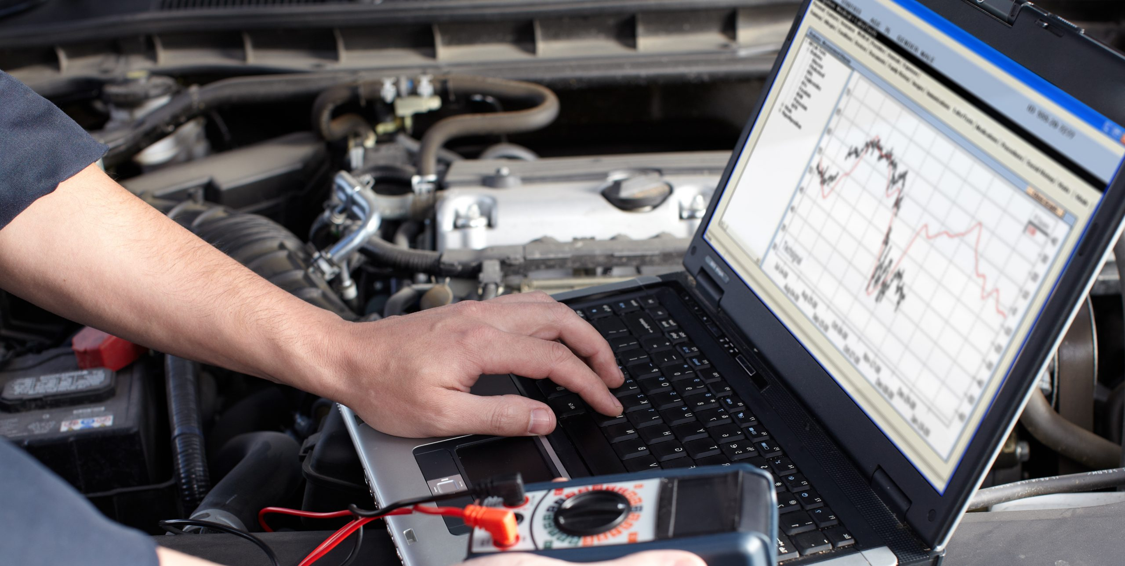
Right to Repair
Would you by equipment from someone that did their own repairs
What if software or TPMs were compromised
Liabilities
Warranty Issues
Safety Concerns, WSIB
Right to Repair does not mean right to modify
Notes:
if computer programs are damaged, who is liable, are there warranty or other safety concerns
Modifying Technological Protection Measures (TPMs) settings on equipment may:
Lower resale value of any equipment
Have unintended consequences of untested coding, that pose unnecessary and avoidable safety risks
Void or violate warranty provisions

Slide 2
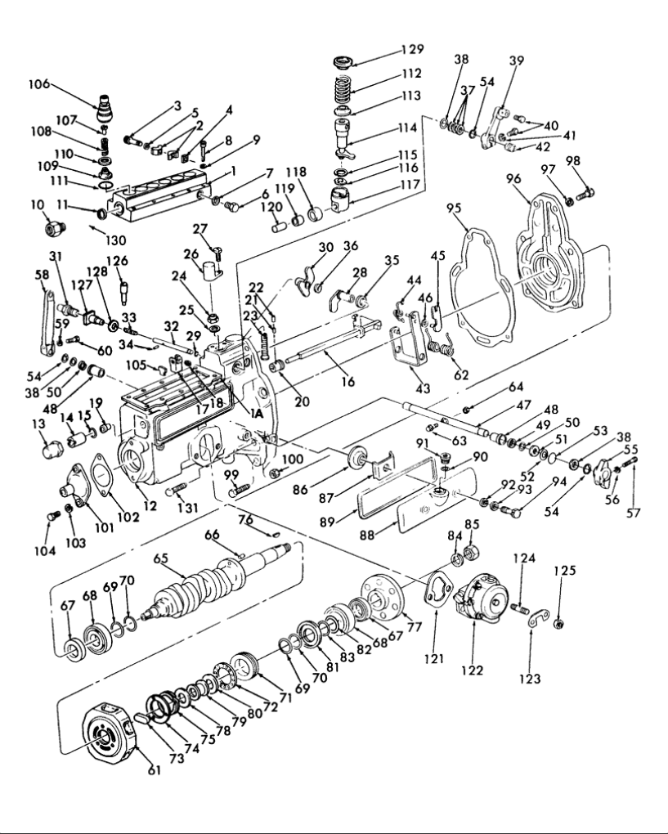
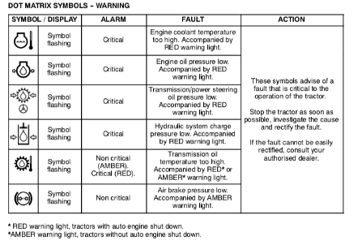



Sensor Errors in the Field
Notes:
But realistically, you run a business that depends on critical timing during a few weeks of the year
It isn’t always practical to get a dealer service call (and pay their travel time both ways) or bring equipment into a service shop.

Slide 3
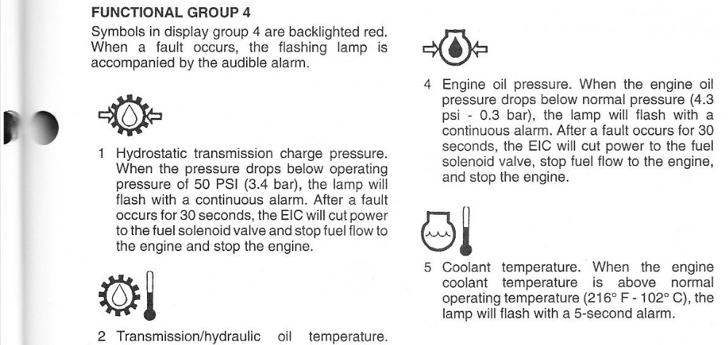
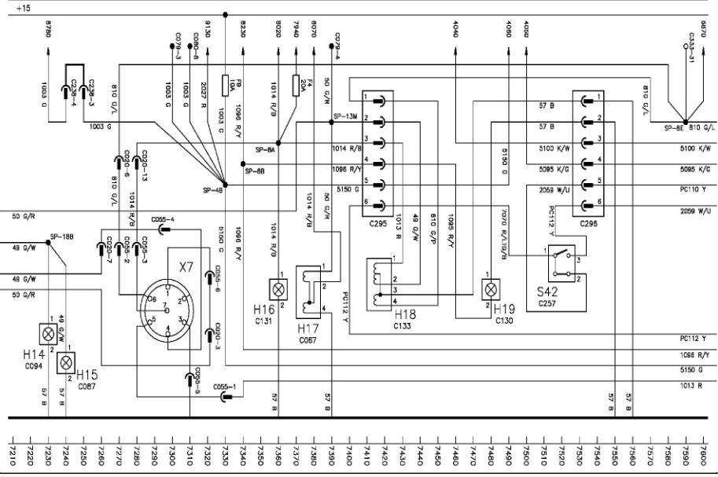
Resetting Warning and Error Codes
Engine Information Centre software cuts power in Tier 4 emissions compliant motors…
Even if OEMs make fault codes available,
you still may be infringing on copyright protection
Notes:
If pressure, temp, or amperage sensors acting up – the EIC will cut power
Even if you can access codes
“Approved” Password Generators @ $150, single device trouble shooting software @ $200, and fault code readers @ $700
Highway truck interfaces are +$3500, tractor ones are +$7500,

Slide 4
ISED Framework
Innovation, Science and Economic Development Canada ( ISED ) works to build fair, competitive marketplaces. ISED’s Marketplace Framework is the legal and regulatory environment within which business and consumers must function.
Framework policies ensure Canada's marketplace is structured to encourage innovation, investment and competitiveness, while protecting the interest of Canadian citizens.
The Framework encompasses copyright policy, in addition to corporate, patent, trademark, industrial design, privacy and data policies. International dimensions of this Framework are guided by International Intellectual Property policy.
Consultation on a Modern Copyright Framework for Artificial Intelligence and the Internet of Things 2021
Notes:
ISED leads 18 federal departments and agencies including the Business Development Bank of Canada, FedDev Ontario, FedNor, and StatsCan.

Slide 5
Copyright Framework Concerns
Association of Equipment Manufacturers
already provide tools/info but in some cases a trained, licensed service technician needs to repair it
unfettered access will compromise innovation, IP rights, and risks safety and emissions requirements
liability for code modifier, dealer resale trade-in modified equipment and next owners
unfettered ability to modify will effectively destroy the market for used equipment
Canadian Federation of Agriculture
limited capacity to get onboard computers repaired timely and affordably.
equipment far away from service providers and hard to move, we need to do repairs or rely on local technicians to avoid costly delays, particularly during time-sensitive harvest periods.
2021 – Right to Repair and Planned Obsolescence in Agriculture
BE IT RESOLVED that CFA work in with provincial farm organizations to research and engage in discussions regarding farmers’ right to repair and planned obsolescence.
Notes:
Although not directly related to the current Right to Repair environment, there are relevant points in the following highlights of seven submissions, provided with relation to Technological Protection Measures (TPMs) and the Right to Repair. These highlights also reveal stakeholder support or concern with amending the Copyright Act or frameworks to achieve interoperability, and the Right to Repair versus the Right to Modify.
technological protection measures (TPM)
AEM, like Deere, claim there is no need for RtR legislation because they already provide access. They highlight that RtR leg. will mean modifying codes and settings – a disaster for the resale market and brings multiple liability concerns
CFA – we only want access for local shop or farmer to do the repairs – not modify,
Engage - this is why we are here today

Slide 6
Stakeholder Concerns
Agricultural Manufacturers of Canada
Want to reverse engineer software to make equipment interoperable with mainline equipment
Canadian Chamber of Commerce
RtR can introduce uncertainty, misinterpretation, reverse engineering, safety risks, cybersecurity breaches.
Association of Home Appliance Manufacturers
© protections preserve safety & cybersecurity protections. Theft of IP can expose customers to malware, theft of their personal information
John Deere Canada ULC
For 184 years, Deere has committed to fully supporting our customers’ right to maintain, diagnose, and repair their equipment and avoid unanticipated, unproductive, and costly downtime. Through our extensive offerings of repair materials, diagnostic tools, and parts, Deere is already meeting this commitment under the existing legislation.
Notes:
AMC wants to allow reverse engineering of code, (access not modify)
CCC does not support RtR, AHAM does not either, and Deere… well they say they already provide RtR solutions

Slide 7
Deere MOU January 8, 2023
enhance ability of Farmers to timely control the lawful equipment operation and upkeep;
Fair and Reasonable access to OEM Tools, Software and Documentation and Data;
assure no safety controls are compromised through TPM modification;
assure OEM IP and software is protected from modification infringement;
assure emissions controls and power ratings are not compromised or other modification of control measures installed for Clean Air Act compliance and other environmental laws and regulations.
AFBF to encourage Farm Bureau organizations to refrain from introducing, promoting, or supporting Right to Repair legislation that imposes obligations beyond the MOU. If legislation or regulation is enacted, Manufacturer reserve the right to withdraw from this MOU
Notes:
Which brings us to the MOU recently signed between Deere and Co and the AFB

Slide 8
How do we move forward
TPMs add a layer of protection on top of the legal protection afforded by copyright law. Circumvention, with limited exceptions, is prohibited under the Copyright Act.
However, TPMs raise challenges related to competition. They restrict legitimate non-infringing activities, such as repairs and enabling interoperability, which has a negative effect on competition and innovation.
Framework or legislation Provincial vs Federal or MOU
AAFC or farm federations
Access to everyone or only certified technicians
Avoid equipment with unduly difficult access, or with DEF/SCR
Rational Position
A variety of repair options in areas with long wait times and difficulty getting an OEM’s authorized repairer
Delays in repairing agricultural equipment during peak harvesting time risks significant loss of income. Removing barriers to installing 3rd-party parts increases availability and reduces the price of replacement parts, allowing customers to extend the lifespan of their products and equipment.

Slide 9
Copyright Act amendments
Ss. 41.21(1) allows regulations to exclude any TPM or class of TPMs from prohibitions provided the TPMs unduly restrict competition in the aftermarket sector.
Exceptions could apply to owners and ISOs, and to manufacture, import, distribution, sell or rent circumvention technology, devices or components to diagnose, maintain or repair
Contract law, Consumer Protection law regarding warranties, access to replacement parts, will still be barriers for consumer and ISO diagnosis and repair.
The copyright framework can complement efforts, including enforcement of the Competition Act and legislative changes at the provincial level:
  creates a level playing field between ISOs and OEMs’ preferred repairers;
  provides choice to owners for self-repair or repair by their preferred third party; and
  enables use non-OEM replacement parts.
Notes:
The Competition Board of Canada looked at this and sees room in the Act to allow regs if TPMs unduly restrict access to allow access for diagnosis
But that isn’t enough, this involves some rules that remove barriers
Comp Board feels that a framework would complement the legislative efforts
We have exemptions now for enabling interoperability with limitations – official computers. Software. codes

Slide 10
Undue restriction
Assessing an ‘undue’ restriction to competition can involve in-depth, case-by-case analysis based on complex economic analysis. Undue means improperly, excessively, inordinately and even wrongly. Such an assessment can be time consuming and resource intensive. However, different approaches to assess competition in repair markets have been used in other jurisdictions in different contexts.
For example, the Australian Productivity Commission (APC) ‘Right to Repair’ study used a qualitative approach to assess competition in repair markets based on the following assessment criteria:
Is there evidence that repair market competition is restricted (concentration, barriers to entry, profit margins, or limits on third-party access to repair supplies)?
Is there harm to consumers (manufacturer in-house repair, contracts, hard to estimate repair costs, lower prices in ISO market, reduced choice, inconvenience)?
Where possible, the benefits to competition should be maximized while also fulfilling other policy objectives.
Notes:
Other regions, Australia, decided to go with a qualitative approach to assess undue restriction to competition

Slide 11
Competition Act
The inability to legally circumvent TPMs for legitimate repairs, reduces consumer choice, and creates barriers for businesses to compete in downstream markets. There are consumer and business benefits to an exception for owners and ISOs to repair.
Competition Act provisions may apply to OEMs’ use of TPMs to restrict competition; S.75 (Refusal to Deal); S.76 (Price Maintenance); S.77 (Exclusive Dealing Tied Selling and Market Restriction); and S.79 (Abuse of Dominant Position). All these sections may be adjudication before the Competition Tribunal.

