Slide 1
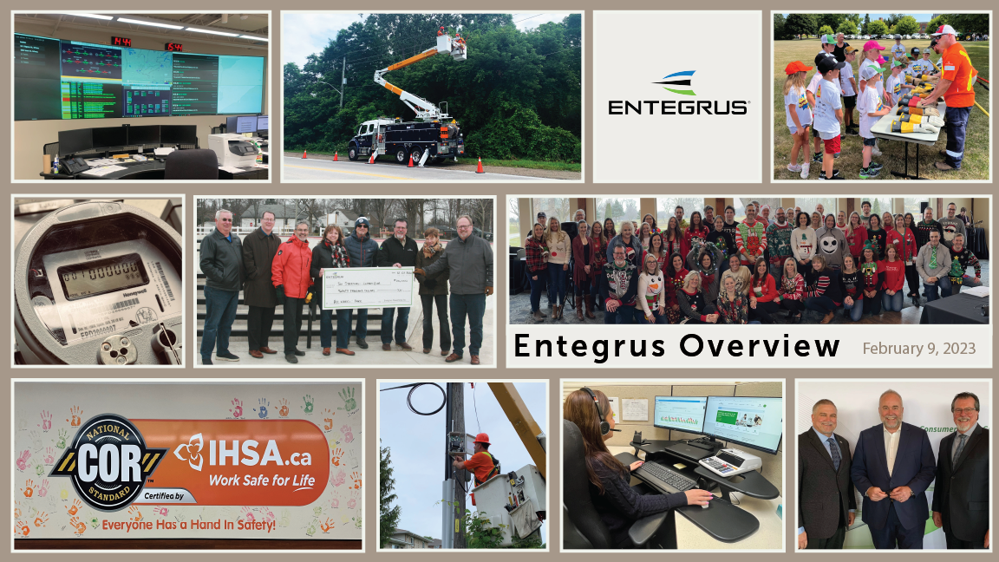
Entegrus Inc. Overview

Slide 2
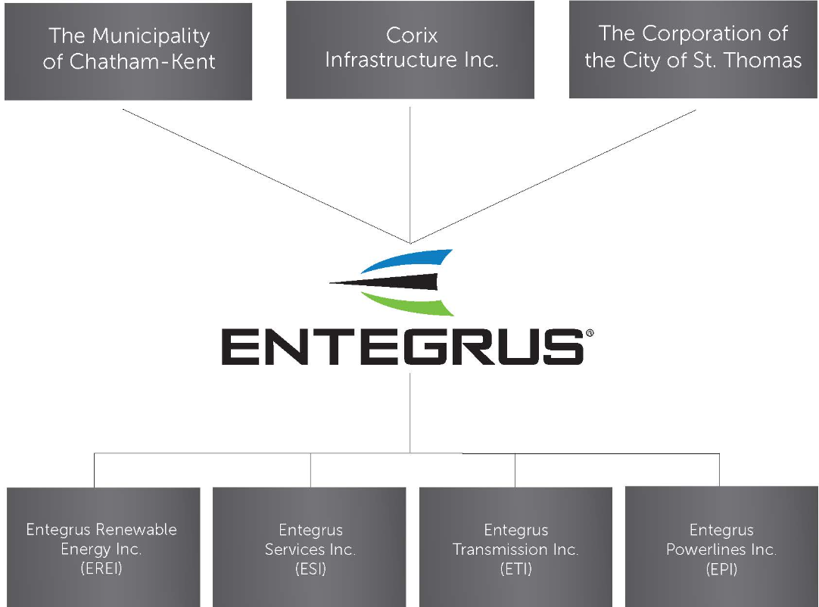
Entegrus Corporate Org Chart
Notes:
Three shareholders
Municipally owned corporation
Non municipal shareholder, provides additional governance and financial advice for unregulated businesses

Slide 3
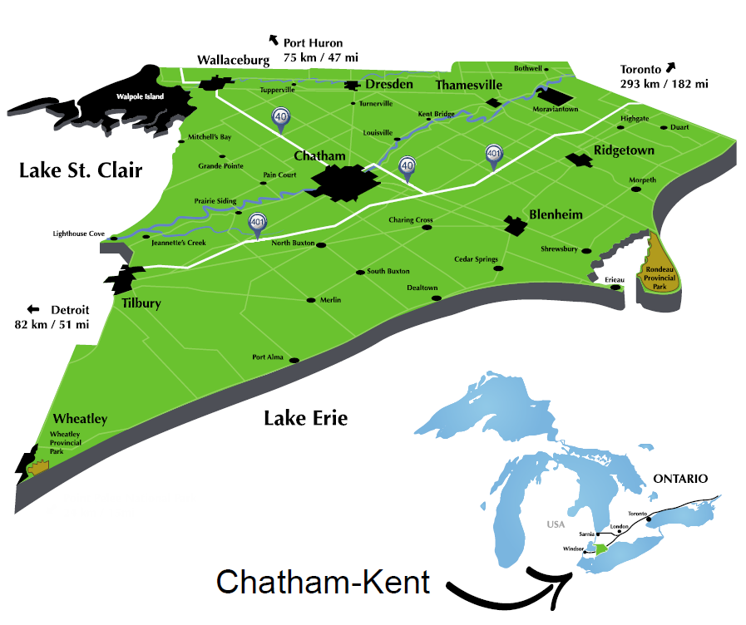
Chatham-Kent
ONE Tier Government
Population of 104,316 (2021 Census)
2,458 sq. km’s
~600,000 Acres
110 KM of Shoreline
Stable government permitting process
550 Wind Turbines , 1050 MW of installed capacity
Notes:
80% of our land is agricultural now this is an estimate , Municipal estimates are that 250,000 acres are under leases or optioned to be leased in CK
2021 census data said we have more farmland than land in our community
talk about 2008 recession . Lost 18 manufacturers , ag crossed over to represent more than50% of our GDP
Farmers signed up in droves before we knew it we had a wind farm in Chatham kent
We had some furious councilors , and angry residents

Slide 4
IESO Procurement
After more than a decade of strong supply, Ontario is entering a period of emerging electricity system needs, driven by increasing demand, the refurbishment of nuclear generating units, as well as expiring contracts for existing facilities
To address these needs, the IESO is competitively securing 3,500 MW of capacity through the first Long-Term Request for Proposals (LT1 RFP), complimentary expedited procurement process “the Expedited Process” (E-LT1 RFP), and the Same Technology Upgrade Solicitation.
Notes:
Add to this that the province has eliminated all of our coal plants, everything is going electric and even natural gas is getting a bad wrap because it is a carbon fuel
So Nuclear, wind , solar or battery are our choice to close the gap

Slide 5
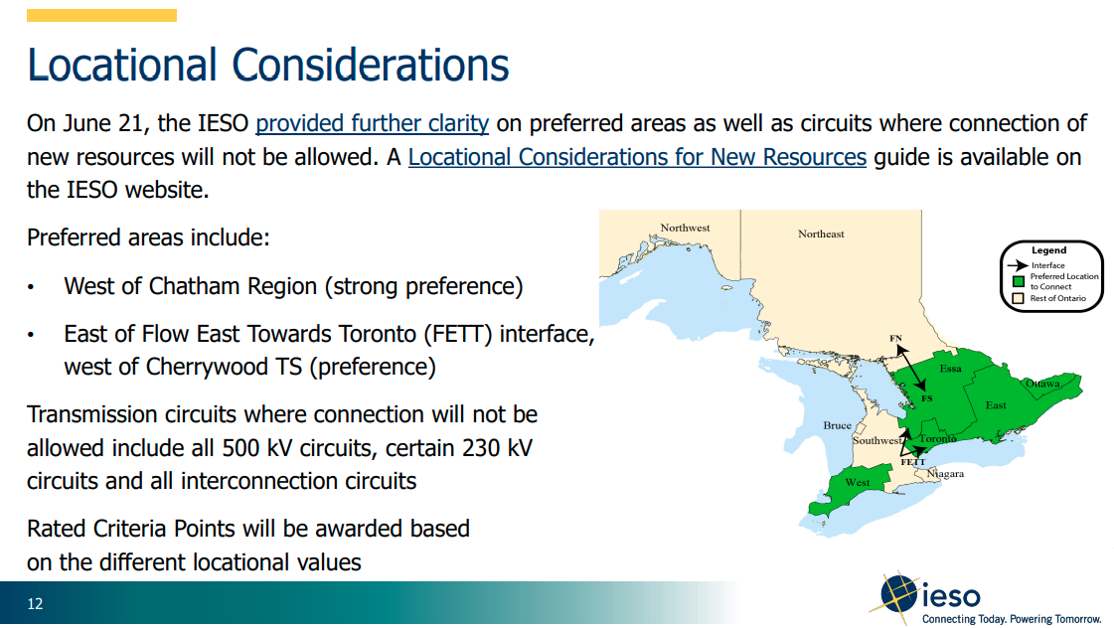
Locational Considerations
Notes:
We often get asked where will these be installed ..close to load and designed to bypass bottelnecks in the transmission system

Slide 6
Battery Storage Projects in C-K
Wheat Energy Storage (RES Canada)
  Project Technology - Lithium-ion battery energy storage system
  Project Contract Capacity – 75-150 MW
  Project Size – approximately 6 hectares (15 acres)
Chatham Battery Energy Storage (Boralex Inc.)
  Project Technology - Lithium-ion battery energy storage system
  Project Contract Capacity – up to 600 MW
  Project Size – up to 9.3 hectares (23 acres)
Notes:
That brings us to today
I believe you met with Adam butterfield from the IESO
There are 3 RFP’s 2 in 2023 and one planned for 2024/2025 timeline and while the current RFP’s are focused on battery storage and some gas expansion the 2024/2025 RFP will
What do you want wind or solar ..gas is

Slide 7
Battery Storage Projects in C-K cont…
Chatham-Kent BESS (Kruger Energy and Innergex)
Project Technology - Lithium-ion battery energy storage system
Project Contract Capacity – 100-145 MW
Project Size – approximately 5.7 hectares (14 acres)
On February 13th C-K Council voted in favour of providing all of the above battery projects a support resolution

Slide 8
Council Support Resolutions
One additional project, a 12 MW CHP plant associated with a greenhouse was also approved
Several questions were raised about the new technology and additional consultation by the developers was needed
Notes:
And out council reports

Slide 9
Questions Asked
What is a Battery Energy Storage System and what type of structures will be on site?
Why is Battery Storage needed in Ontario and is it a long-term beneficial solution?
Why is Battery Storage needed in Chatham-Kent?
Why are the facilities being proposed on farmland and is that permitted?

Slide 10
Questions Asked
What are the potential impacts of Battery
What type of foundations are required and how deep will they be?
Energy Storage Systems and how safe are they (public safety, fire, environmental contamination, etc.)?
Have other municipalities provided support for these types of projects?

Slide 11
Questions Asked
Why can’t these be installed in the city?
Notes:
They can but much smaller systems will be installed and they will have less system benefit because they are local

Slide 12
Thank You!
Questions?

Slide 13
Land Use Considerations
Notes:
So why the differences …the money isn’t there on some projects…some projects cost more and some project just simply provide more value to the IESO and the province
This is a capacity payment , and a KW payment
Adalaie, Lambton , napanee, Middlesex county – avoid class one farm lands

Slide 14

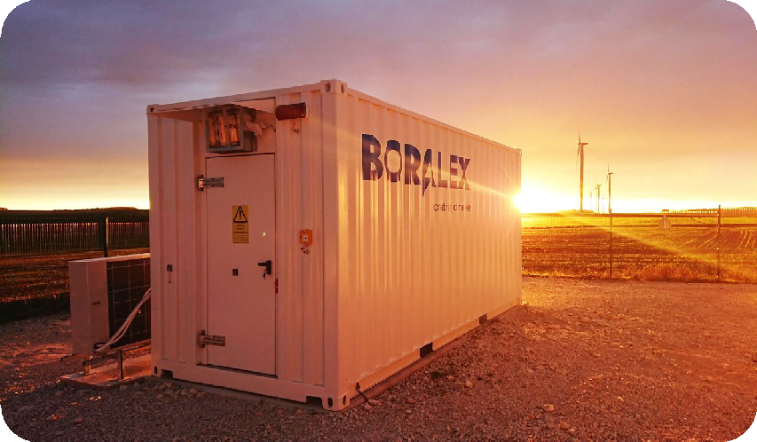
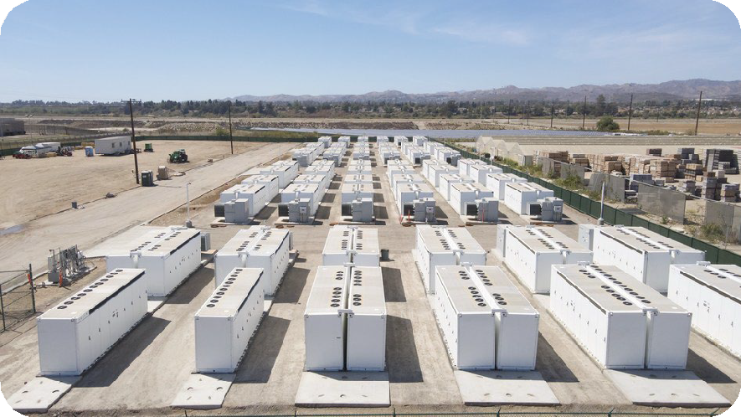
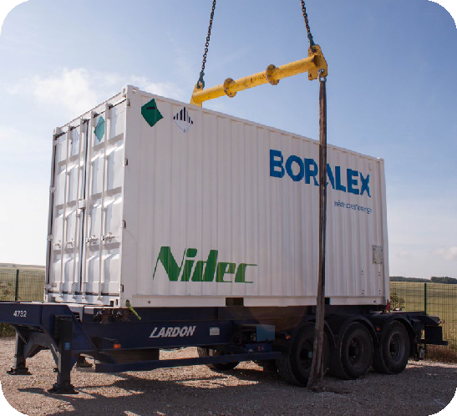
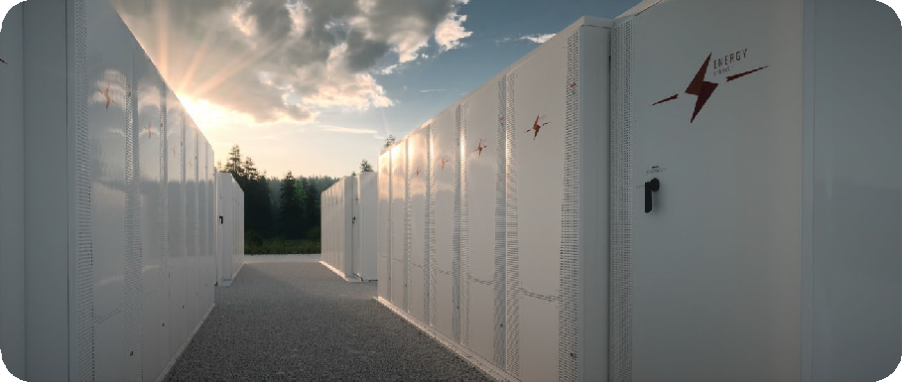
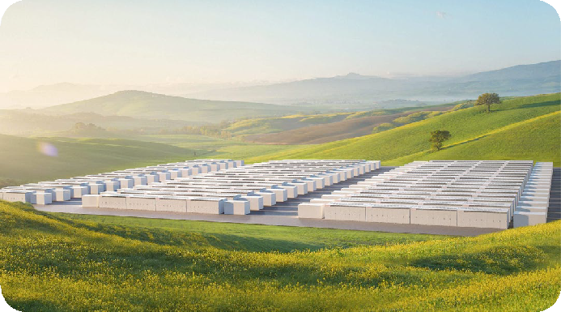
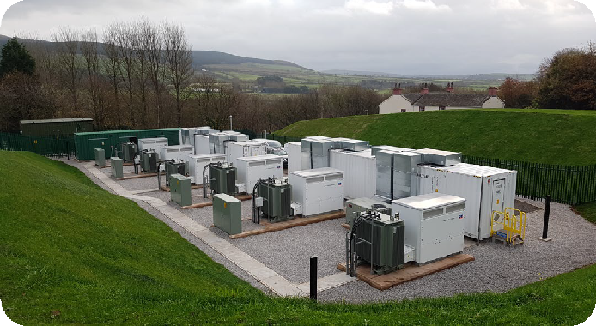
What a BESS Project Looks Like

Slide 15
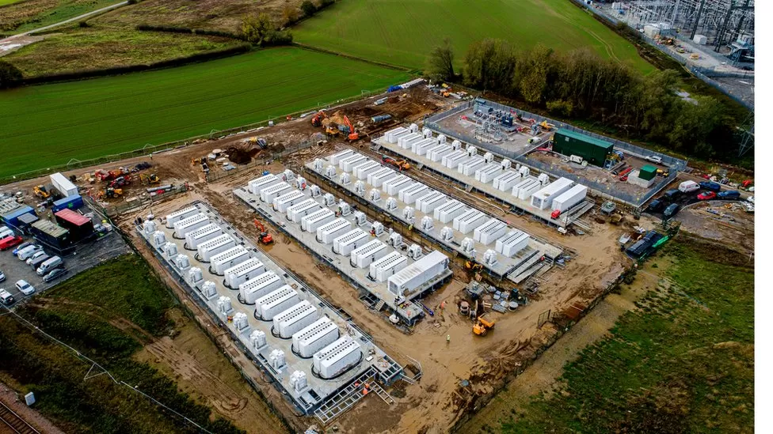
Notes:
Quick question by a sow of hands
How many of you ether make or know a farmer who makes $100/year of profit, pre profit per acre …can you just raise your hand ., keep it up if you or someone you know makes $200/ acre personally $500/acre
1000/acres
5000?acre?
$10,000 per acre per year leally I mean you have to oay income tax on it if you cant find some write offs but I mean $10,000 profit per acre per year- legally?
$25,000/acre – why doesn’t Hydro One pay these kind of rates? Because core infrastructure, water gas electricity

Slide 16
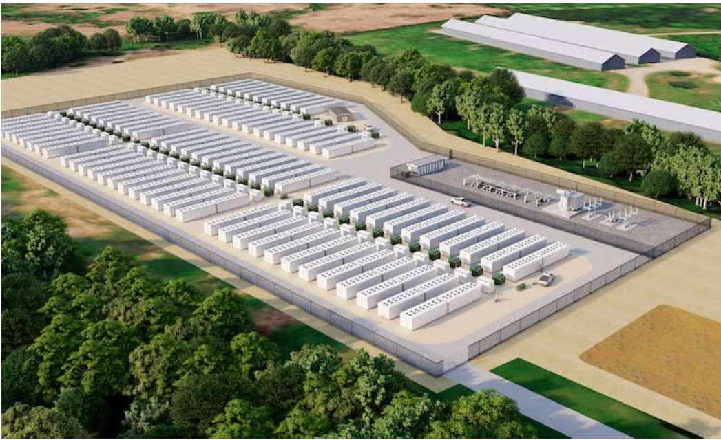

Slide 17
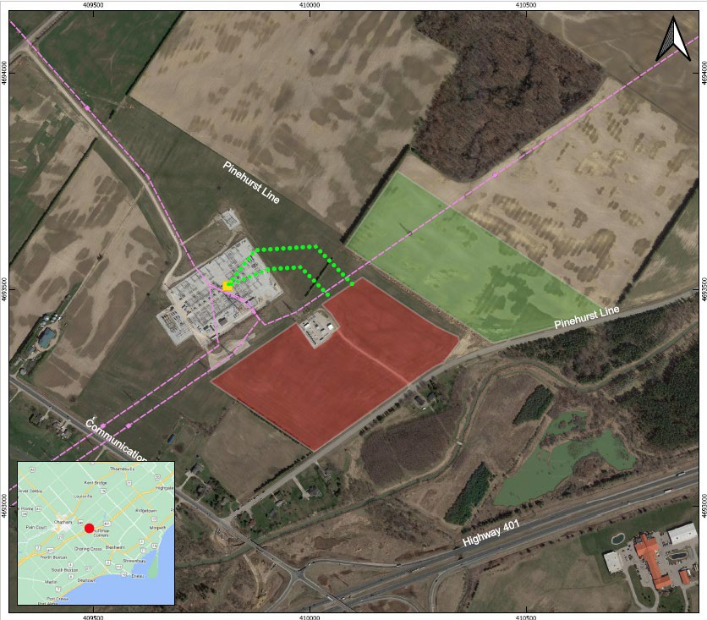
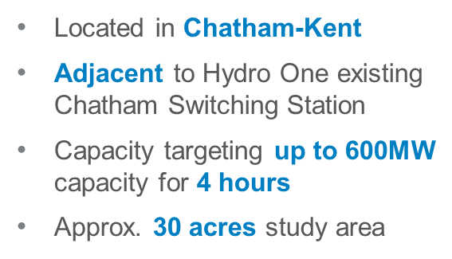
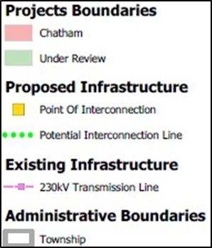
Review: Boralex Submission
Notes:
Located in Chatham-Kent
Adjacent to Hydro One existing Chatham Switching Station
Capacity targeting up to 600MW
capacity for 4 hours
Approx. 30 acres study area

Slide 18
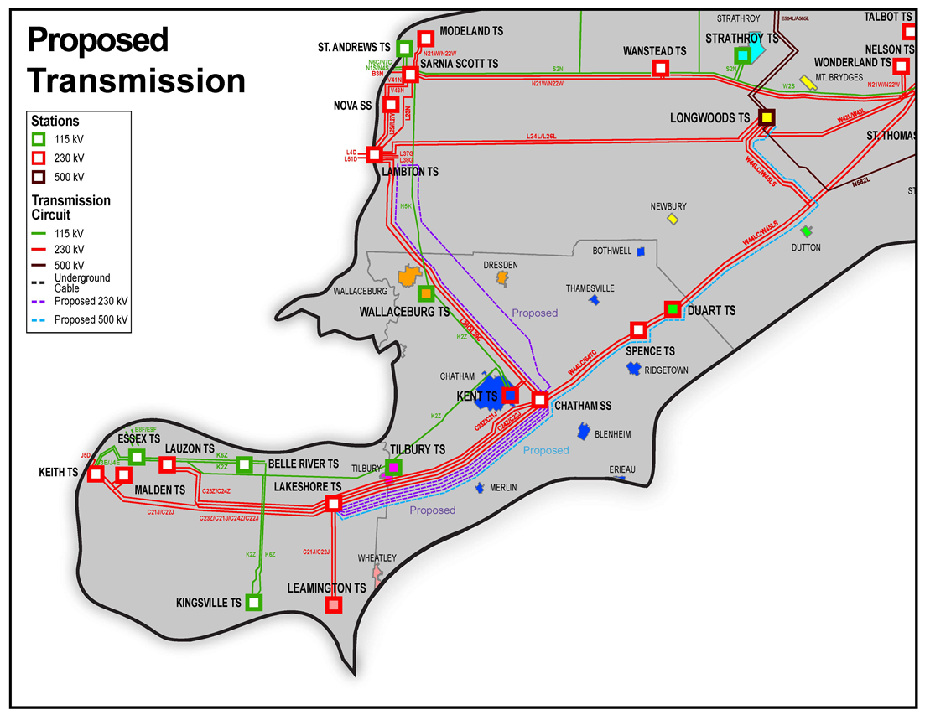
Notes:
Multiple transmission lines are proposed in the west of London region.
The concentration and cumulative impacts of the proposed transmission lines in Chatham-Kent is material
A proactive solution is needed to meet provincial objectives

Slide 19
Chatham-Kent
ONE Tier Government
Population of 104,316 (2021 Census)
2,458 sq. km’s
~600,000 Acres
110 KM of Shoreline
Stable government permitting process
550 Wind Turbines , 1050 MW of installed capacity
Notes:
80% of our land is agricultural now this is an estimate , Municipal estimates are that 250,000 acres are under leases or optioned to be leased in CK
2021 census data said we have more farmland than land in our community
talk about 2008 recession . Lost 18 manufacturers , ag crossed over to represent more than50% of our GDP
Farmers signed up in droves before we knew it we had a wind farm in Chatham kent
We had some furious councilors , and angry residents

Slide 20
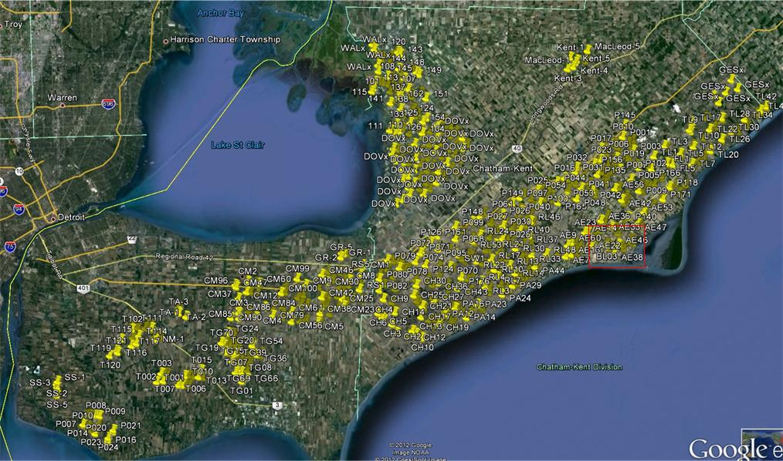

Slide 21
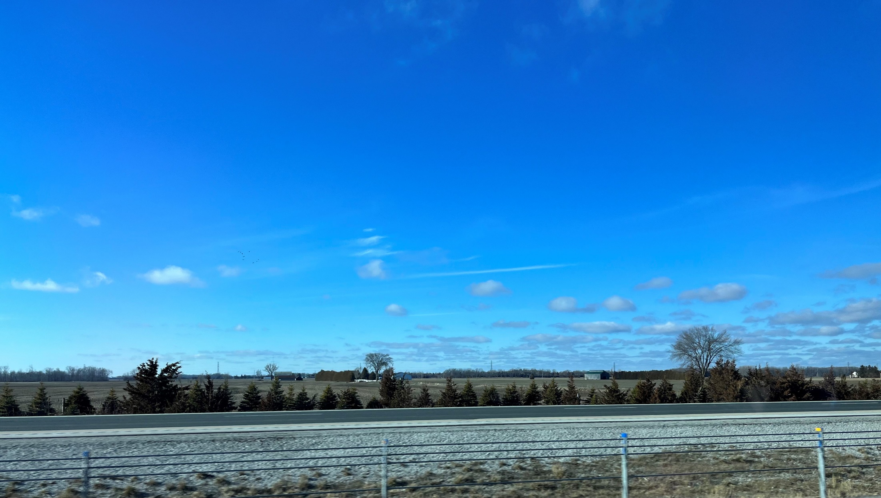

Slide 22
